Slide 1
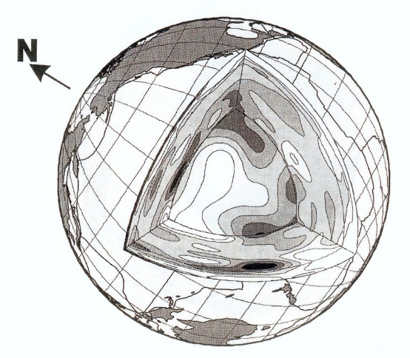

"Multi-parameter seismic inversion".
Joint Inversion –velocity/hypocenter
By J. Virieux, professor UGA
Anticline
Fault
Salt Dome
Pinchout
Unconformity
American Petroleum Institute, 1986

Slide 2
Understanding …
Performing travel time tomography requires
- ray theory for the forward problem
- optimization theory for the inverse problem
If not, you may have a chance to play with many parameters … with limited success.

Slide 3
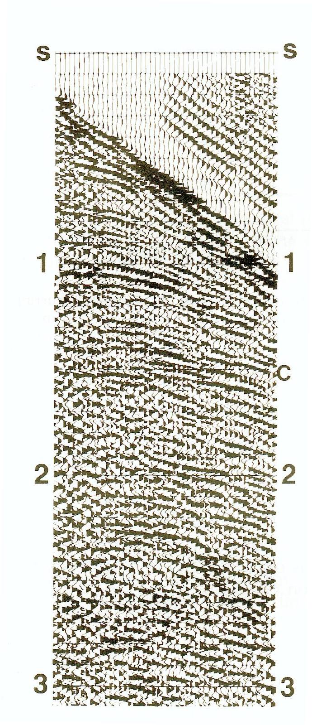
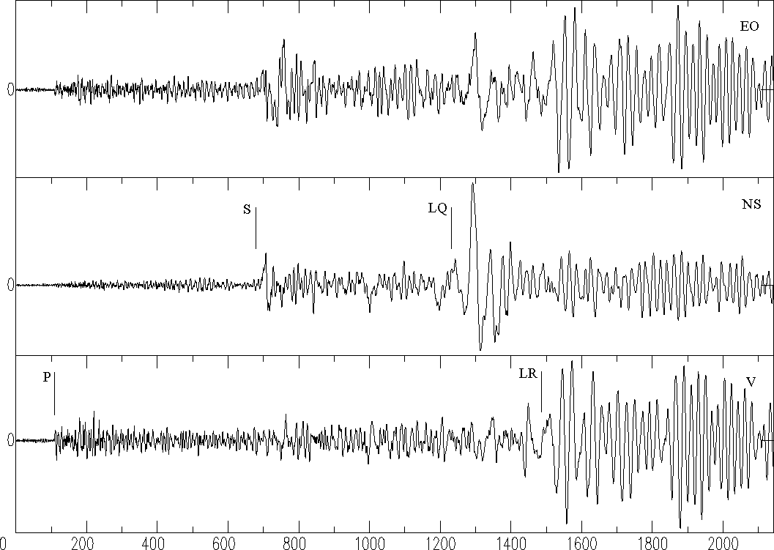
Time scales
Source time
from 0.1 sec to 100 sec (rupture vel.)
Wave time
from secondes to hours
Window time
from few secondes to days

Slide 4
Length scales
Fault length
200 km for vr=2 km/s
Discontinuity distance
from few meters to few 100 kms
Volume sampling
from few kms to few 1000 kms

Slide 5
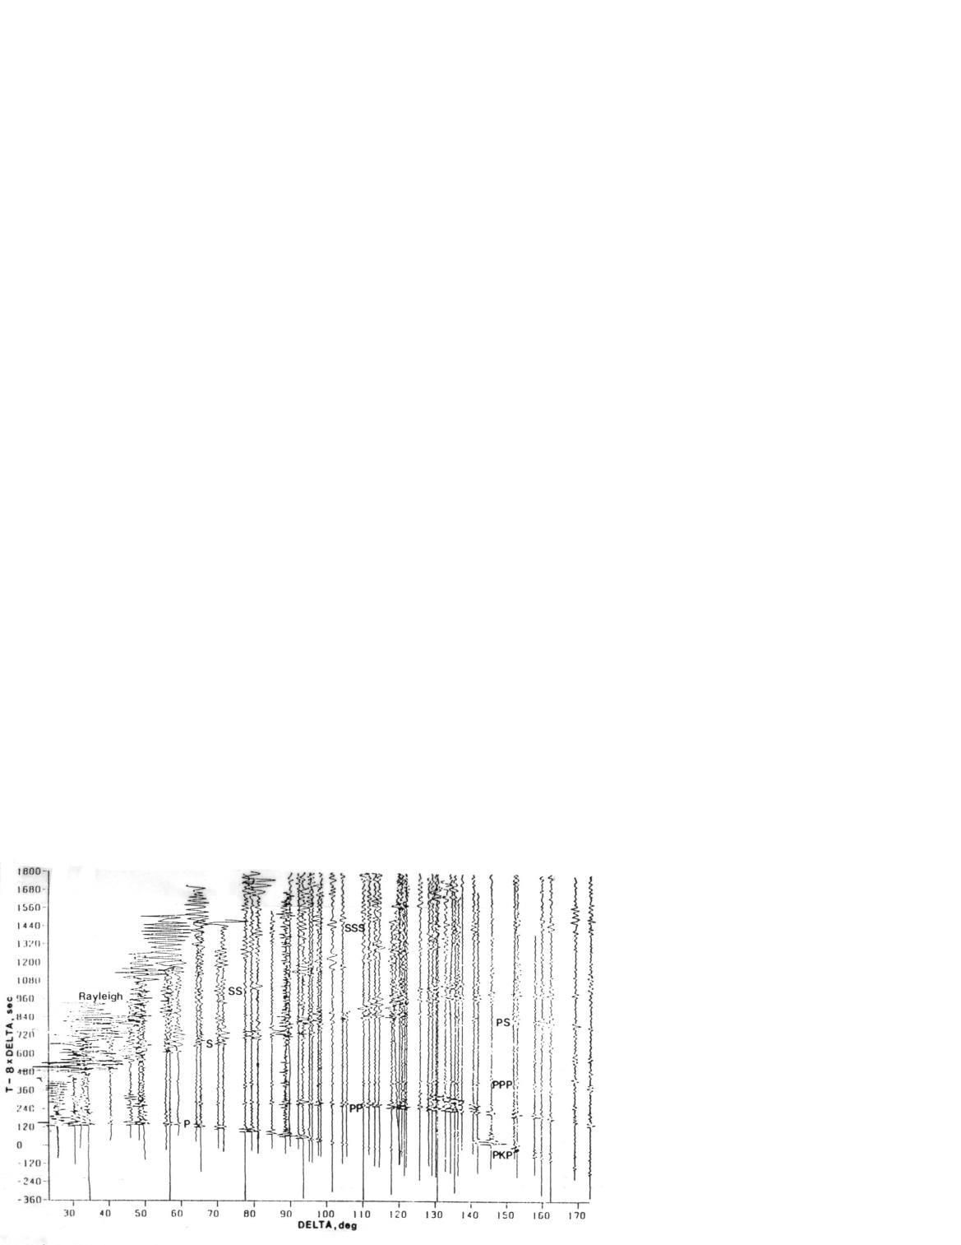
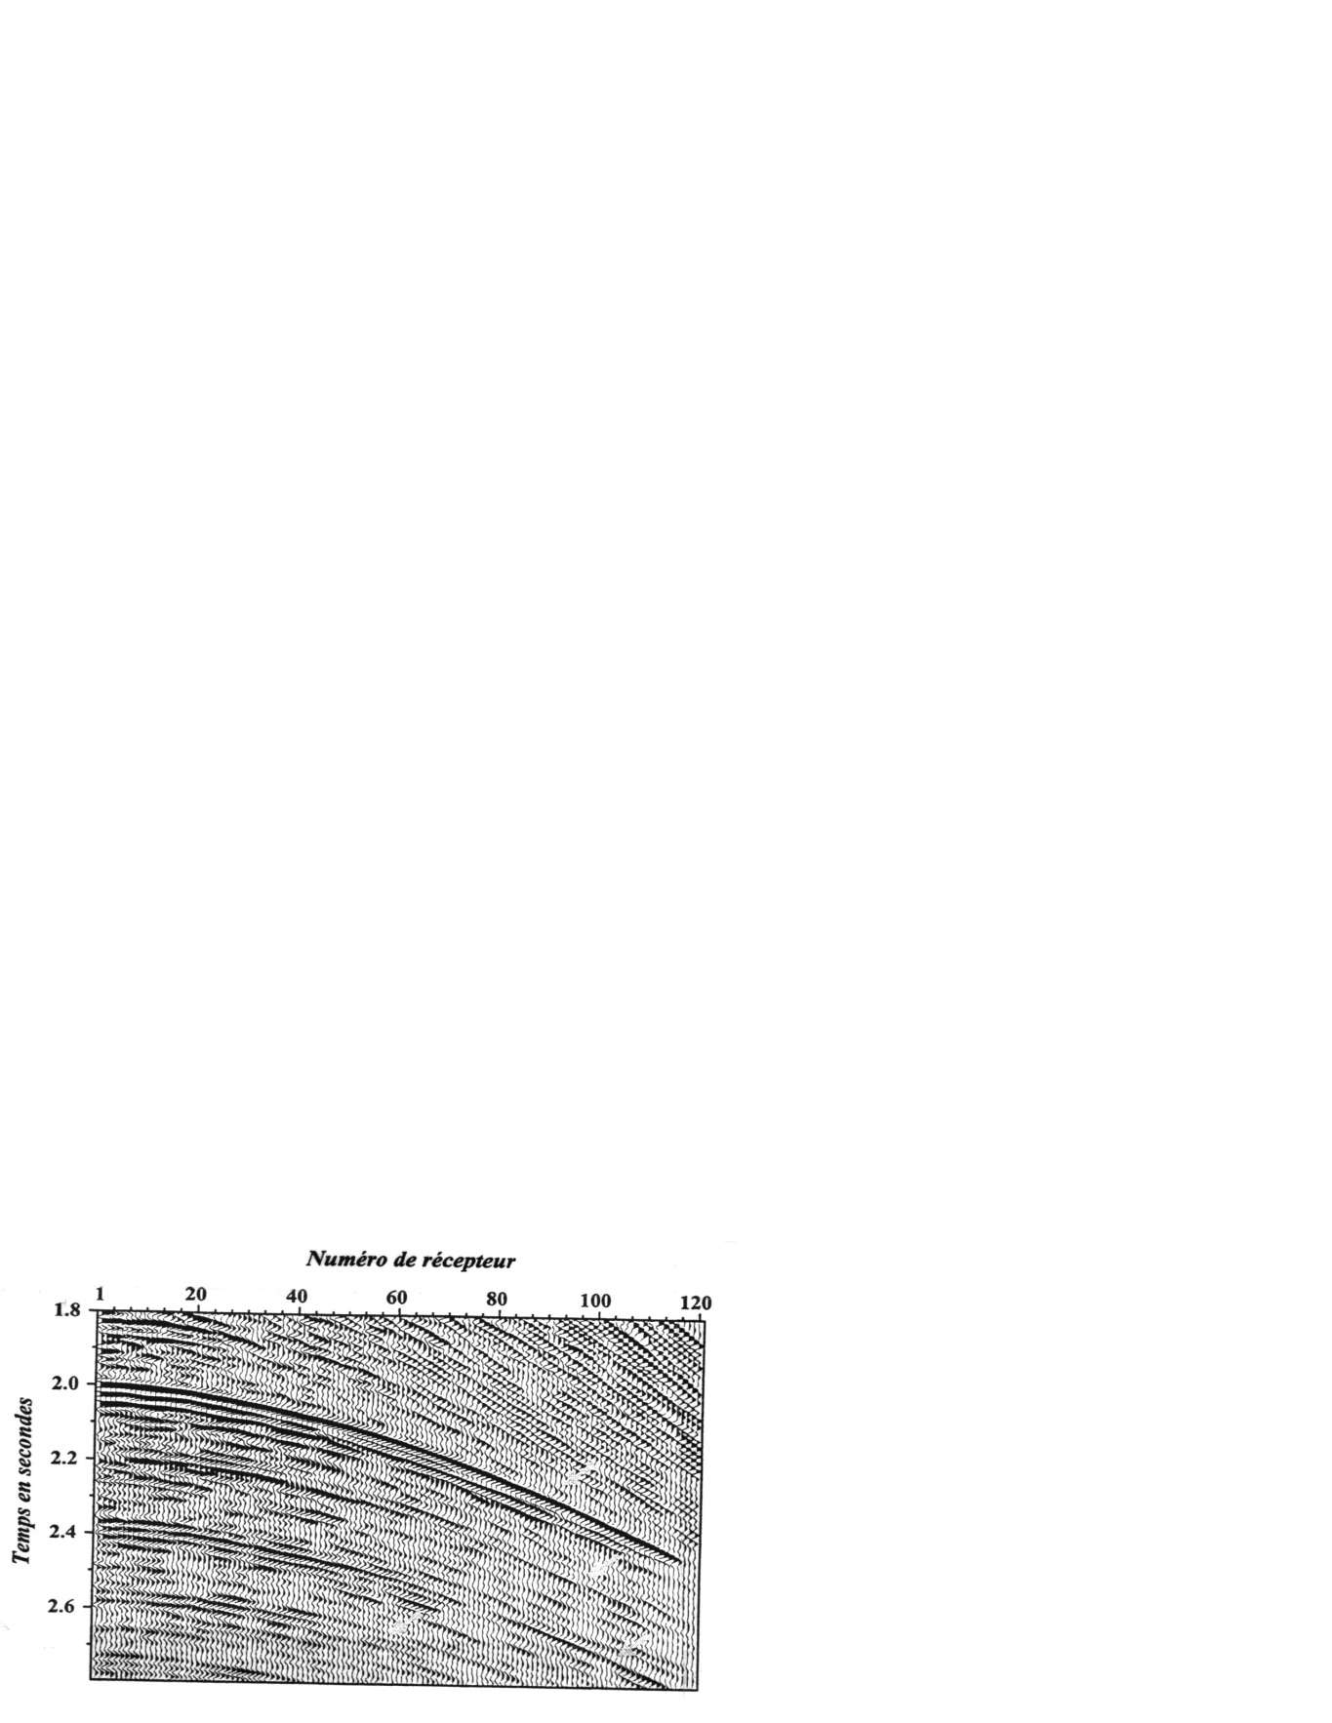
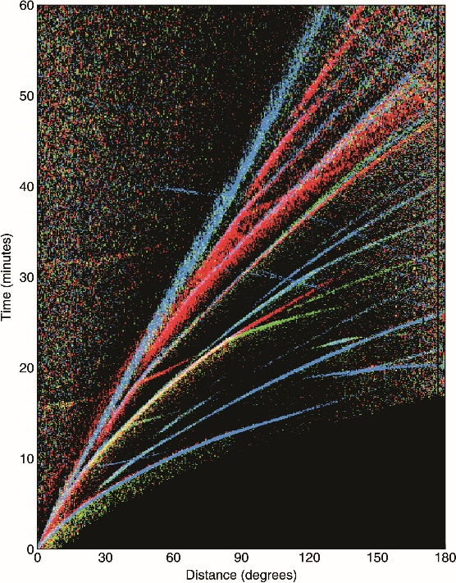
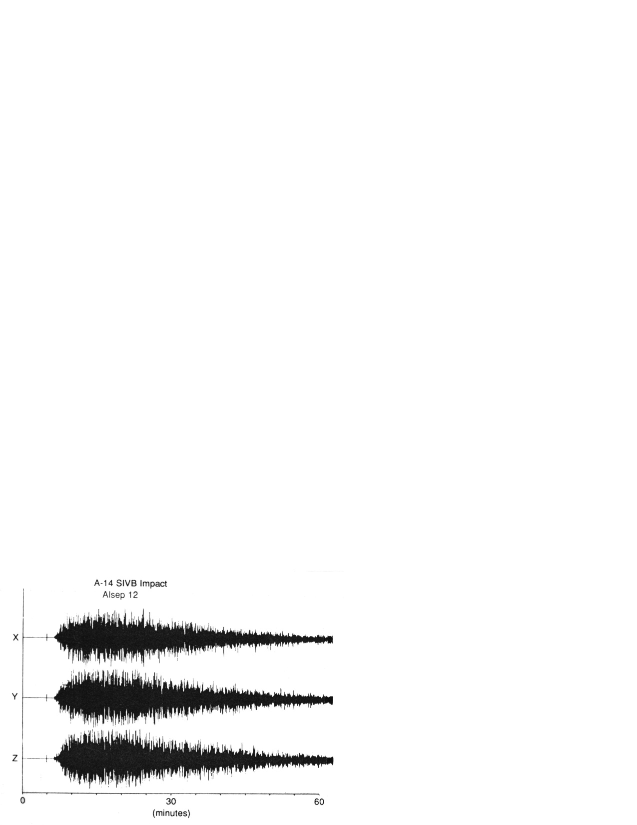
Examples
Record of a far earthquake (Müller and Kind, 1976)
Traces from a oil reservoir (Thierry, 1997)
Seismic imaging is a tough problem on the Moon !
Records on the Moon (meteoritic impact) (Latham et al., 1971)

Slide 6
Motivation
Delayed travel-time tomography source:receiver
Fitting times => estimation of times
=> 2-pts rays: millions!
Full Waveform Inversion/Migration src/rec:focal point
Same challenge with an order increase in magnitude
Seismogram modeling
Handling multiple arrivals and filling gaps (shadows)
Rays ⬄ Geometrical Optics ⬄Infinite Frequency ⬄Singularities topology
A link with the Catastrophe Theory (René Thom)
Do we need this complexity?

Slide 7
Ray+Born approach
Ray tracing efficient only in smooth media
Updating the velocity structure through iterations induces a dramatic increasing complexity in ray tracing: people stays often (always) with the initial ray tracing once done (Background model~Born)
Asymptotic theory (or high frequency approximation) introduces a complexity in our finite frequency seismic wave propagation : all scales are there while they are not present in the seismic data
In fluid mechanism:
physics below a given small scale is parametrized (upscaled)

Slide 8
References
Červený, V., Seismic ray theory, Cambridge University Press, 2001
Chapman, C., Fundamentals of seismic wave propagation, Cambridge University Press, 2004
Slawinski, M.A., Seismic waves and rays in elastic media, Handbook of geophysical exploration, seismic, exploration, volume 34, Pergamon, 2003
Abdullaev, S.S., Chaos and dynamics of rays in waveguide media, Gordon and Breach Science Publishers, 1993
Goldstein, H, Classical mechanics, Addison-Wesley Publishing company, second edition,1980
Glassner, A.S. (editor), An introduction to ray tracing, Academic Press, second edition, 1991
Gilmore, R, Catastrophe theory for scientists and engineers, Wiley & Sons, Inc, 1981.
Sethian, J.A., Level Set Methods and Fast Marching Methods: Evolving Interfaces in Computational Geometry, Fluid Mechanics, Computer Vision, and Materials Science, Cambridge University Press, 1999.
Virieux, J. and Lambaré, G., Theory and Observations-Body waves: Ray methods and finite frequency effecs in Treatrise on Geophysics, Tome I by A. Diewonski and B. Romanowicz, Elsevier, 2010

Slide 9
References (selection)
Červený, V., Seismic ray theory, Cambridge University Press, 2001
Chapman, C., Fundamentals of seismic wave propagation, Cambridge University Press, 2004

Slide 10
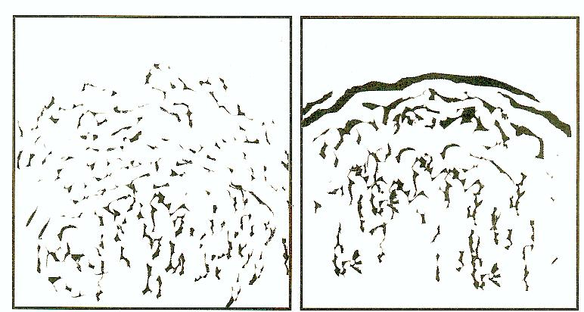
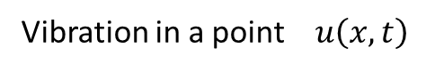
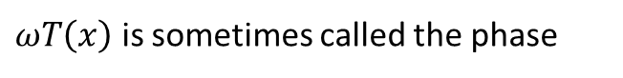
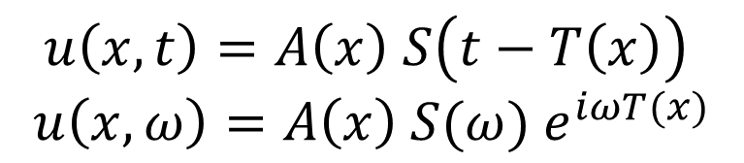
Translucid Earth
Vibration in a point$u\left(x,t\right)$
S(t)
$$u\left(x,t\right)=A\left(x\right) S\left(t−T\left(x\right)\right)$$
$$u\left(x,ω\right)=A\left(x\right) S(ω){ e}^{iωT(x)}$$
Source
Same shape !
Travel-time T(x) and Amplitude A(x)
T(x)
Receiver
$ωT\left(x\right)$ is sometimes called the phase
Wavefront : T(x)=T₀
Diffracting medium:
wavefront coherence lost !
Wavefront preserved

Slide 11
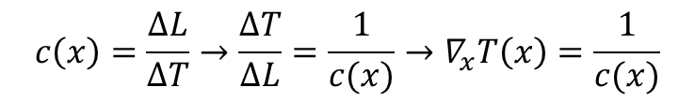
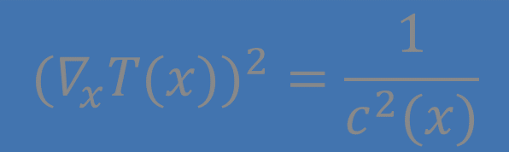
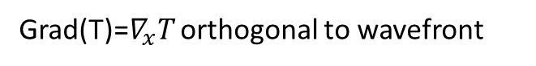
Eikonal equation
Two simple interpretations of wavefront evolution
Orthogonal trajectories are rays in an isotropic medium
T=cte
Velocity c(x)
Grad(T)=$∇_{x}T$ orthogonal to wavefront
ΔL
Ray
$$c\left(x\right)=\frac{ΔL}{ΔT}→\frac{ΔT}{ΔL}=\frac{1}{c(x)}→∇_{x}T\left(x\right)=\frac{1}{c(x)}$$
T+ΔT
Direction ? : abs or square
The orientation of the wavefront could not be guessed from the local information on a specific wavefront
11

Slide 12
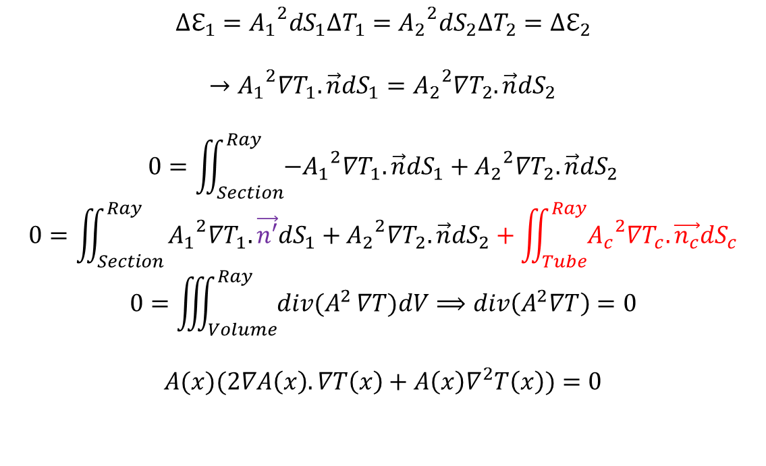
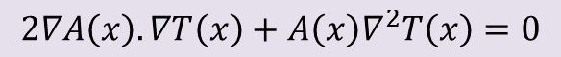
Transport Equation
Tracing neighboring rays defines a ray tube : variation of amplitude depends on energy flux conservation through sections.
Energy flux same at section one and at section two
$$∆ℇ_{1}={A_{1}}^{2}dS_{1}∆T_{1}={A_{2}}^{2}dS_{2}∆T_{2}={∆ℇ}_{2}$$
$$→{A_{1}}^{2}∇T_{1}.\vec{n}dS_{1}={A_{2}}^{2}∇T_{2}.\vec{n}dS_{2}$$
$$0=\iint_{Section}^{Ray}{{{−A}_{1}}^{2}∇T_{1}.\vec{n}dS_{1}+{A_{2}}^{2}∇T_{2}.\vec{n}dS_{2}}$$
$$0=\iint_{Section}^{Ray}{{A_{1}}^{2}∇T_{1}.\vec{n′}dS_{1}+{A_{2}}^{2}∇T_{2}.\vec{n}dS_{2}}+\iint_{Tube}^{Ray}{{A_{c}}^{2}∇T_{c}.\vec{n_{c}}dS_{c}}$$
$$0=\iiint_{Volume}^{Ray}{div(A^{2}}∇T)dV⟹div\left(A^{2}∇T\right)=0$$
$$A(x)(2∇A\left(x\right).∇T\left(x\right)+A\left(x\right)∇^{2}T\left(x\right))=0$$
net contribution=zero
$$2∇A\left(x\right).∇T\left(x\right)+A\left(x\right)∇^{2}T\left(x\right)=0$$

Slide 13
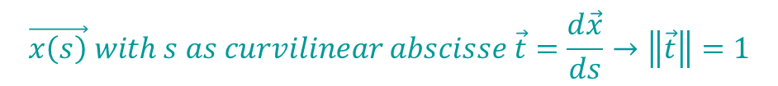
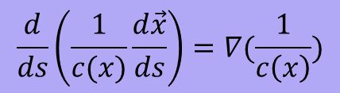
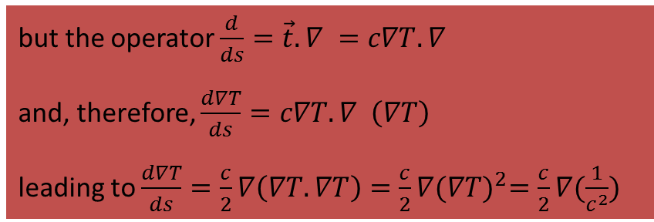
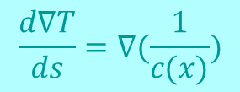

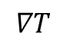
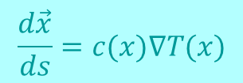
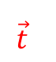
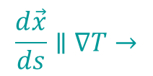
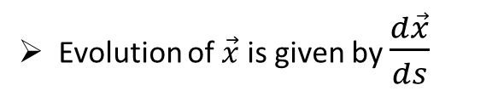
Ray equation
$$\vec{x\left(s\right)} with s as curvilinear abscisse \vec{t}=\frac{d\vec{x}}{ds}→\left\|\vec{t}\right\|=1$$
Wavefront
$$∇T$$
Evolution of $\vec{x}$ is given by $\frac{d\vec{x}}{ds}$
$$\vec{t}$$
Ray
$$\frac{d\vec{x}}{ds}∥∇T→$$
$$\frac{d\vec{x}}{ds}=c(x)∇T(x)$$
T=cte
Evolution of $∇T$ is given by $\frac{d∇T}{ds}$
Ray equations
but the operator $\frac{d}{ds}=\vec{t}.∇ =c∇T.∇$
and, therefore, $\frac{d∇T}{ds}=c∇T.∇ \left(∇T\right)$
leading to $\frac{d∇T}{ds}=\frac{c}{2}∇\left(∇T.∇T\right)=\frac{c}{2}∇{(∇T)}^{2}=\frac{c}{2}∇(\frac{1}{c^{2}})$
$$\frac{d∇T}{ds}=∇(\frac{1}{c(x)})$$
$$\frac{d}{ds}\left(\frac{1}{c(x)}\frac{d\vec{x}}{ds}\right)=∇(\frac{1}{c\left(x\right)})$$
Curvature equation
We define the slownss vector $\vec{p}=∇T\left(x\right)$ and the position $\vec{q}=\vec{x}(s)$ along the ray

Slide 14
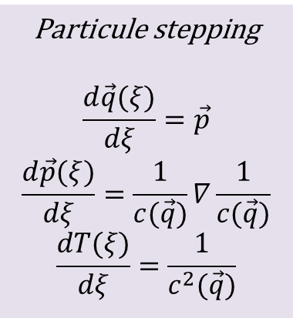
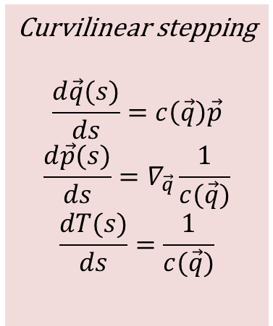
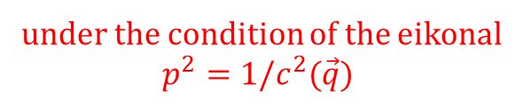
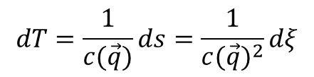
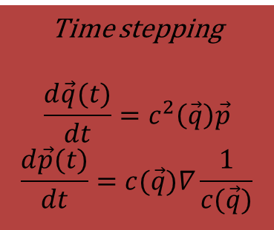
Various non-linear ray equations
Curvilinear stepping
$$\frac{d\vec{q}(s)}{ds}=c\left(\vec{q}\right)\vec{p}$$
$$\frac{d\vec{p}(s)}{ds}=∇_{\vec{q}}\frac{1}{c(\vec{q})}$$
$$\frac{dT(s)}{ds}=\frac{1}{c(\vec{q})}$$
Particule stepping
$$\frac{d\vec{q}(ξ)}{dξ}=\vec{p}$$
$$\frac{d\vec{p}(ξ)}{dξ}=\frac{1}{c(\vec{q})}∇\frac{1}{c(\vec{q})}$$
$$\frac{dT(ξ)}{dξ}=\frac{1}{c^{2}(\vec{q})}$$
The simplest set
Time stepping
$$\frac{d\vec{q}(t)}{dt}=c^{2}\left(\vec{q}\right)\vec{p}$$
$$\frac{d\vec{p}(t)}{dt}=c(\vec{q})∇\frac{1}{c(\vec{q})}$$
$$dT=\frac{1}{c(\vec{q})}ds=\frac{1}{{c(\vec{q})}^{2}}dξ$$
under the condition of the eikonal
$p^{2}=1/c^{2}(\vec{q})$
Which ODE to select for numerical solving ? Either t or ξ sampling.
Many analytical solutions (gradient of velocity; gradient of slowness square)

Slide 15
How to solve these equations ODE versus PDE !

Slide 16
ODE Lagrangian formulation Wavefront complexity

Slide 17
Methods of characteristics
Differential geometry (Courant & Hilbert, 1966)
Non-linear ordinary differential equations
Lagrangian formulation as we integrate along rays
In opposition to Eulerian formulation where we compute (ray) quantities at fixed positions

Slide 18
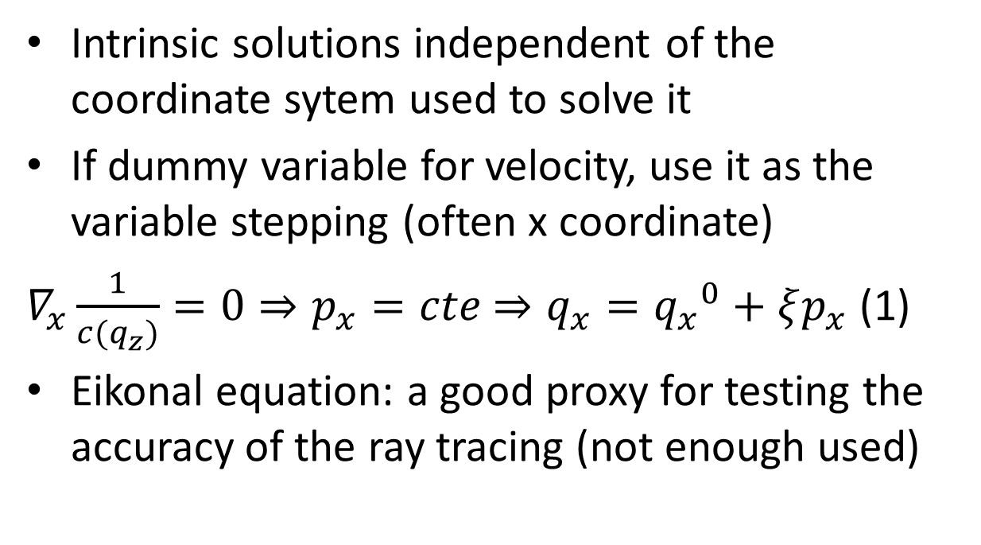
Properties of these ODEs
Intrinsic solutions independent of the coordinate sytem used to solve it
If dummy variable for velocity, use it as the variable stepping (often x coordinate)
$∇_{x}\frac{1}{c(q_{z})}=0⇒p_{x}=cte$ $⇒q_{x}={q_{x}}^{0}+ξp_{x}$ (1)
Eikonal equation: a good proxy for testing the accuracy of the ray tracing (not enough used)
In 3D: six or seven equations
In 2D: four or five equations
(1): rectilinear motion of a particle along this axis in mechanics

Slide 19
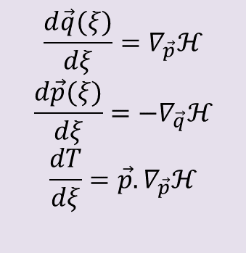
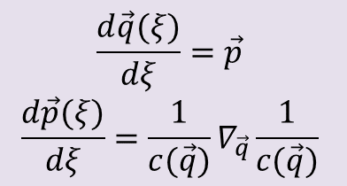
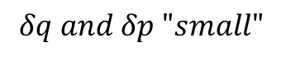
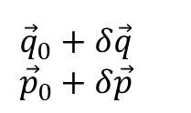
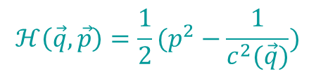
Hamilton’s (ray) equations
$$\frac{d\vec{q}(ξ)}{dξ}=∇_{\vec{p}}ℋ$$
$$\frac{d\vec{p}(ξ)}{dξ}={−∇}_{\vec{q}}ℋ$$
$$\frac{dT}{dξ}=\vec{p}.∇_{\vec{p}}ℋ$$
$$ℋ\left(\vec{q},\vec{p}\right)=\frac{1}{2}(p^{2}−\frac{1}{c^{2}(\vec{q})})$$
$$\frac{d\vec{q}(ξ)}{dξ}=\vec{p}$$
$$\frac{d\vec{p}(ξ)}{dξ}=\frac{1}{c(\vec{q})}∇_{\vec{q}}\frac{1}{c(\vec{q})}$$
Mechanics : ray tracing as a particular balistic problem
sympletic structure (FUN!)
Hamilton approach suitable for perturbation
(Henri Poincaré en 1907 « Mécanique céleste »,
Richard Feymann Prix Nobel 1965)
$${\vec{q}}_{0}+δ\vec{q}$$
$${\vec{p}}_{0}+δ\vec{p}$$
$$δq and δp "small"$$
Information around the ray
Ray
Meaning of the neighborhood zone
Fresnel zone if finite frequency
Any zone depending on your problem GBS

Slide 20
Velocity variation v(z)
Ray equations are
The horizontal component of the slowness vector is constant: the trajectory is inside a plan which is called the plan of propagation. We may define the frame (xoz) as this plane.
Where p_{x} is a constante
For a ray towards the depth

Slide 21
Velocity variation v(z)
z_{p}
At a given maximum depth z_{p}, the slowness vector is horizontal following the equation
If we consider a source at the free surface as well as the receiver, we get
In Spherical frame
In Cartesian frame
with p = usini

Slide 22
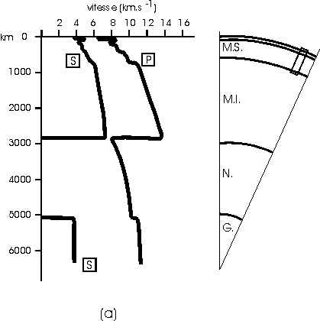
Velocity structure in the Earth
Radial Structure
(PREM, JB …)

Slide 23
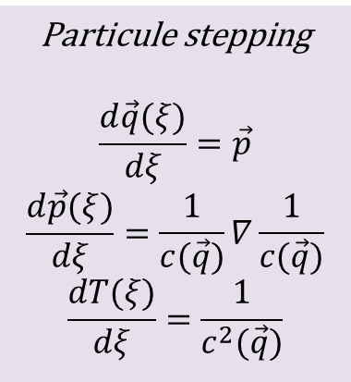
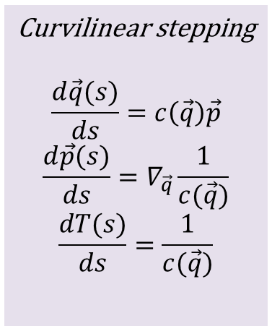
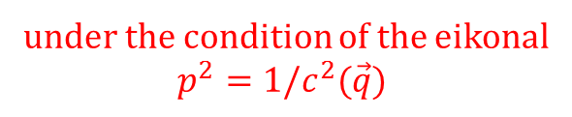
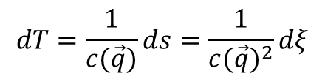
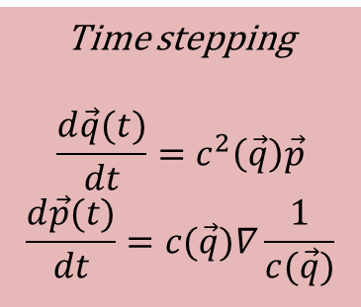
System of ray tracing equations
Curvilinear stepping
$$\frac{d\vec{q}(s)}{ds}=c\left(\vec{q}\right)\vec{p}$$
$$\frac{d\vec{p}(s)}{ds}=∇_{\vec{q}}\frac{1}{c(\vec{q})}$$
$$\frac{dT(s)}{ds}=\frac{1}{c(\vec{q})}$$
Particule stepping
$$\frac{d\vec{q}(ξ)}{dξ}=\vec{p}$$
$$\frac{d\vec{p}(ξ)}{dξ}=\frac{1}{c(\vec{q})}∇\frac{1}{c(\vec{q})}$$
$$\frac{dT(ξ)}{dξ}=\frac{1}{c^{2}(\vec{q})}$$
The simplest set
Time stepping
$$\frac{d\vec{q}(t)}{dt}=c^{2}\left(\vec{q}\right)\vec{p}$$
$$\frac{d\vec{p}(t)}{dt}=c(\vec{q})∇\frac{1}{c(\vec{q})}$$
$$dT=\frac{1}{c(\vec{q})}ds=\frac{1}{{c(\vec{q})}^{2}}dξ$$
under the condition of the eikonal
$p^{2}=1/c^{2}(\vec{q})$
Which ODE to select for numerical solving ? Either t or ξ sampling.
Many analytical solutions (gradient of velocity; gradient of slowness square)

Slide 24
Time integration of ray equations
Runge-Kutta second-order integration
Predictor-Corrector integration
1D sampling of 2D/3D medium : FAST
stiffness
receiver
Initial conditions EASY
?
source
receiver
Boundary conditions VERY DIFFICULT
?
Shooting δp ?
Bending δx ?
Continuing δc ?
source
Save p conditions if possible !
AND FROM TIME TO TIME IT FAILS !
But we need 2 points ray tracing because we have a source and a receiver to be connected in seismology!

Slide 25
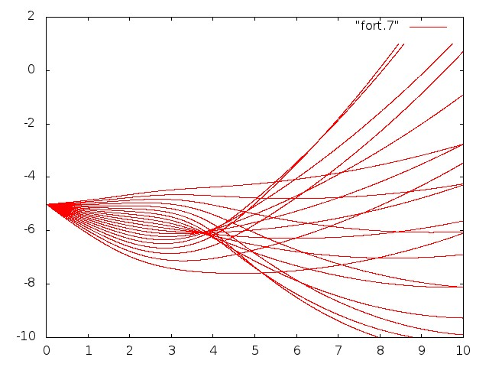
Ray tracing by rays
Ray tracing
Constant angle step

Slide 26
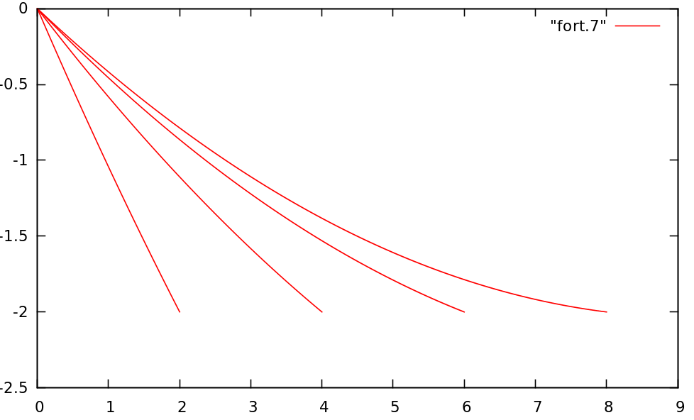
Ray tracing by rays
Two-points ray tracing
Source (0,0)
Receivers (2,-2),
(4,-2),(6,-2)
(depth is considered as negative)
Please note the irregular angle stepping.

Slide 27
Hamilton’s (ray) equations
$$\frac{d\vec{q}(ξ)}{dξ}=∇_{\vec{p}}ℋ$$
$$\frac{d\vec{p}(ξ)}{dξ}={−∇}_{\vec{q}}ℋ$$
$$\frac{dT}{dξ}=\vec{p}.∇_{\vec{p}}ℋ$$
$$ℋ\left(\vec{q},\vec{p}\right)=\frac{1}{2}(p^{2}−\frac{1}{c^{2}(\vec{q})})$$
$$\frac{d\vec{q}(ξ)}{dξ}=\vec{p}$$
$$\frac{d\vec{p}(ξ)}{dξ}=\frac{1}{c(\vec{q})}∇_{\vec{q}}\frac{1}{c(\vec{q})}$$
Mechanics : ray tracing as a particular balistic problem
sympletic structure (FUN!)
Hamilton approach suitable for perturbation
(Henri Poincaré en 1907 « Mécanique céleste »,
Richard Feymann Prix Nobel 1965)
$${\vec{q}}_{0}+δ\vec{q}$$
$${\vec{p}}_{0}+δ\vec{p}$$
$$δq and δp "small"$$
Information around the ray
Ray
Meaning of the neighborhood zone
Fresnel zone if finite frequency
Any zone depending on your problem GBS

Slide 28
ODE resolution
Runge-Kutta of second order
Write a computer program for an analytical law for the velocity: take a gradient with a component along x and a component along z
Home work : redo the same thing with a Runge-Kutta of fourth order
(look after its definition)
Consider a gradient of the square of slowness

Slide 29
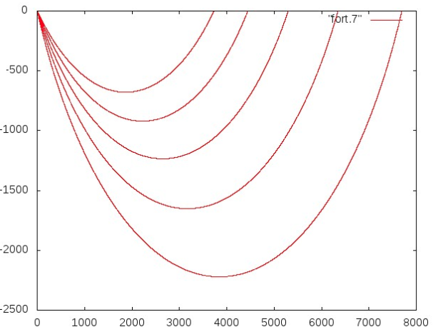
Analytical solutions
Vertical gradient of the velocity
Gradient of the slowness square

Slide 30
Keeping complexity low
Ray tracing is a fast 1D integration in 2D/3D
Ray tracing equations as ODEs may sample the medium quite evenly
They are lagrangian formulation: we follow a point while tracing rays without regarding the density of rays

Slide 31
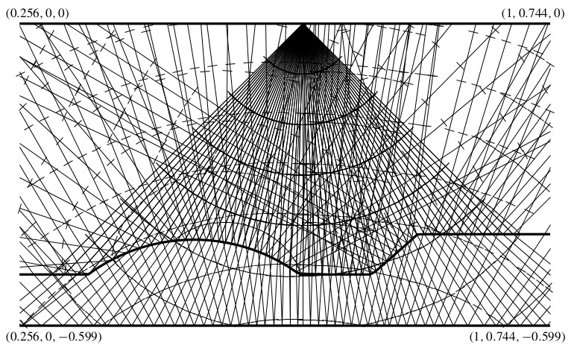
Keeping complexity low
3D French’s model
Not really !!!
Solutions: moving from ODEs to PDEs
(Osher et al, 2002) for adequate spatial sampling of the wavefront. Grids control the complexity!

Slide 32
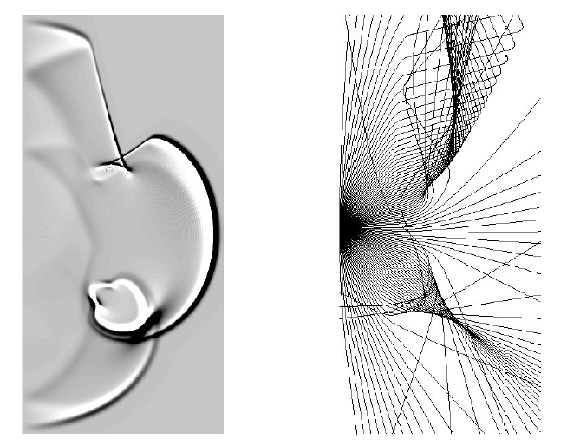
Interpolation challenge
How to find travel times where poor ray sampling!

Slide 33
Mitigating the interpolation issue
We cannot guarantee that two rays will stay nearby for small shooting angles changes
Differential approach will be an answer: the perturbed ray will stay nearby the reference ray …
Key step for seismic tomography (more than ray tracing !)

Slide 34
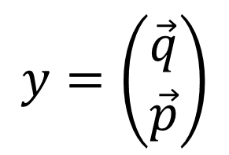
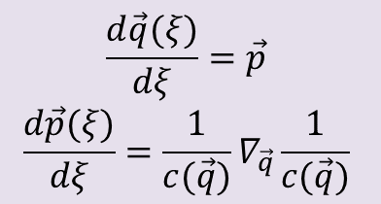
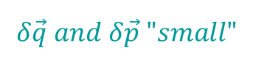





Hamilton’s perturbation
$$ℋ\left(\vec{q},\vec{p}\right)=\frac{1}{2}(p^{2}−\frac{1}{c^{2}(\vec{q})})$$
$$\frac{d\vec{q}(ξ)}{dξ}=∇_{\vec{p}}ℋ$$
$$\frac{d\vec{p}(ξ)}{dξ}={−∇}_{\vec{q}}ℋ$$
$$\frac{dT}{dξ}=\vec{p}.∇_{\vec{p}}ℋ$$
$$\frac{d\vec{q}(ξ)}{dξ}=\vec{p}$$
$$\frac{d\vec{p}(ξ)}{dξ}=\frac{1}{c(\vec{q})}∇_{\vec{q}}\frac{1}{c(\vec{q})}$$
$$y=\left(\begin{matrix}\vec{q} \\ \vec{p}\end{matrix}\right)$$
$${\vec{q}}_{0}+δ\vec{q}$$
$${\vec{p}}_{0}+δ\vec{p}$$
$$δ\vec{q} and δ\vec{p} "small"$$
Information around the ray $y_{0}$
$$δy=\left(\begin{matrix}\vec{δq} \\ \vec{δp}\end{matrix}\right)$$
Ray

Slide 35


STEP ONE: ray tracing
(Lambaré et al., 1996)

Slide 36
Local ODE Semi-Lagrangian approach Sampling control
Interpolation issue

Slide 37
Ray tracing by wavefronts
(Ray tracing by rays)
How to compute multiple arrivals?
Evolution over time:
folding of the wavefront is allowed (still a significant curse of complexity!)
Dynamic sampling:
undersampling of ray fans
oversampling of ray fans
Lambaré et al (1996)
Vinje et al (1993) widely used in NORSAR software
Keep an « uniform » sampling of the medium by rays
by tracking the surrounding density of rays
by estimating through paraxial approach the ray density

Slide 38

Ray tracing by wavefronts
An ODE is solved at each point of the wavefront while it is spanned
Keeping the sampling of the medium more or less uniform
Rays and wavefronts in an homogeneous medium.
(Lambaré et al., 1996)

Slide 39

Ray tracing by wavefronts
How to compute multiple arrivals?
Sampling the wavefront is an heavy task in 2D & 3D !
Still better than oversampling through ray tracing by rays
Example of wavefront evolution in a smooth version of the Marmousi model
Smoothness is required !

Slide 40

(Runbord, 2007)

Slide 41

Geometrical optics resolution
No scale as we are at infinite frequency !
Is it a fair assumption while we have finite frequency wave content?
We must proceed down to a given resolution length under which we do not want to decipher the wavefront: wavefront healing related to so-called viscous solution.
Do we need this complexity of tracking seismic wavefronts!

Slide 42
Few attempts
The medium should be smooth enough for avoiding the wavefront tracking …
Usually done once in the initial model when performing imaging procedure …
A better strategy? Yes, for first arrivals; maybe for multiple arrivals.

Slide 43
PDE Eulerian approach Grid control

Slide 44




Level-set functions
$$p^{2}=\frac{1}{c^{2}(\vec{x})}$$
$$ℋ\left(\vec{x},\vec{p}\right)=\frac{1}{2}\left(p^{2}−\frac{1}{c^{2}\left(\vec{x}\right)}\right)=0$$
Eikonal equation
The eikonal equation is a first-order non-linear partial differential equation of static Hamilton-Jacobi equations: Crandall & Lions (1983, 1984) have shown that « viscous » solutions of such equation can be obtained.
« Computing first-arrival times is equivalent to tracking an interface advancing at a local speed normal to itself » from Sethian & Popovici (1999)
Level-set methods (Osher & Sethian, 1988)
Fast marching methods (Sethian, 1996a; Sethian and Popovici, 1999) $𝒪(NLogN)$
Fast sweeping methods (Zhao, 2005) $𝒪(N)$
Discontinuous Finite-Element methods (Li et al, 2008; Yan & Osher, 2011)
$$\left|\vec{p}\right|=\frac{1}{c(\vec{x})}=\left|∇_{\vec{x}}T(\vec{x})\right| \vec{x}∈Ω$$
$$T\left(\vec{x}\right)=T_{0}\left(\vec{x}\right) \vec{x} ∈ Γ⊂∂Ω$$
Using an upwind, monotone and consistent discretization of $\left|∇_{\vec{x}}T(\vec{x})\right|$

Slide 45


Slide 46


Slide 47





Eikonal Solvers Fast marching method (FMM)
In a 2D layered medium
(tracking interface/wavefront motion: curve and surface evolution)
$${\left(\frac{∂T}{∂x}\right)}^{2}+{\left(\frac{∂T}{∂z}\right)}^{2}=\frac{1}{{c(z)}^{2}}$$
$$\frac{∂T}{∂z}=±\sqrt{\frac{1}{{c(z)}^{2}}−{\left(\frac{∂T}{∂x}\right)}^{2}}$$
Let us assume T is known at a level z=cte
a) $\frac{∂T}{∂x}$
Compute ${∂T}/{∂x}$ along z=cte by a finite difference approximation
z=cte
Deduce ${∂T}/{∂z}$ from eikonal
b) $\frac{∂T}{∂z}$
z
c) down
Extend T estimation at depth z+dz
z + dz
EIKONAL SOLVER
ONLY FIRST-ARRIVAL!
From T at a depth of z, we have been able to estimate T at a depth of z+dz

Slide 48



Fast marching method (FMM)
2D case
$${\left(\frac{∂T}{∂x}\right)}^{2}+{\left(\frac{∂T}{∂z}\right)}^{2}=\frac{1}{{c(x,z)}^{2}}$$
$$\frac{∂T}{∂z}=±\sqrt{\frac{1}{{c(x,z)}^{2}}−{\left(\frac{∂T}{∂x}\right)}^{2}}$$
Computing T(x,z) is a stationay boundary problem: discretize it on a grid and find an efficient numerical method to solve it.
The solution is updated by following the causality in a sequential way: updated pointwise in the order the solution is strictly increasing (upwind difference scheme and a heap-sort algorithm)
Sharp interfaces are difficult to describe
$$𝒪(N LogN)$$
where N is the number of grid points in a direction
From Sethian & Podovici (1999)

Slide 49


ENO or WENO stencil
How to estimate the discrete $\left|∇T\right|$?
A first-order Godunov upwind difference scheme
High-order improved ENO or WENO stencils (Liu et al, 1994; Jiang and Shu, 1996)
See Sethian’s book (1999)
$${\left[{\left(\frac{T_{i,j}−{T_{i,j}}^{xmin}}{h}\right)}^{+}\right]}^{2}+{\left[{\left(\frac{T_{i,j}−{T_{i,j}}^{ymin}}{h}\right)}^{+}\right]}^{2}=\frac{1}{c^{2}(x,z)}$$
with ${T_{i,j}}^{xmin}=min⁡(T_{i−1,j},T_{i+1,j})$ and ${T_{i,j}}^{ymin}=min⁡(T_{i,j−1},T_{i,j+1})$
and with ${\left(x\right)}^{+}=x if x>0$ or ${\left(x\right)}^{+}=0 if x ≤0$

Slide 50


Fast sweeping method (FSM)
2D case
Computing T(x,z) is a stationay boundary problem
$${(\frac{∂T}{∂x})}^{2}+{(\frac{∂T}{∂z})}^{2}=\frac{1}{c^{2}(x,z)}$$
Gauss-Seidel iterations with alternating direction sweepings are incorporated into same upwind finite difference stencil: complexity in $𝒪\left(N\right).$
Velocity
Travel time
In 2D at least four sweeps are needed and six sweeps in 3D
Iterations are independent of the grid size
Singularities at the boundary may induce errors, especially for a point source (Luo & Qian, 2010)
From Zhao (2005)
Any mesh could be used

Slide 51







Fast sweeping method (FSM)
2D case
$${(p_{x})}^{2}+{(p_{z} )}^{2}=\frac{1}{c^{2}(x,z)}$$
Any mesh could be used
$T_{C}=T_{A}+\frac{\vec{AC}.\vec{p}}{AC}AC$ $T_{C}>T_{A}$
$T_{C}=T_{B}+\frac{\vec{BC}.\vec{p}}{BC}BC$ $T_{C}>T_{B}$
Waves travel along AC or BC direction with an apparent slowness which is the projected slowness value from the true slowness vector.
$$\left(\begin{matrix}\frac{x_{C}−x_{A}}{AC} & \frac{z_{C}−z_{A}}{AC} \\ \frac{x_{C}−x_{B}}{BC} & \frac{z_{C}−z_{B}}{BC}\end{matrix}\right)\left(\begin{matrix}p_{x} \\ p_{z}\end{matrix}\right)=\left(\begin{matrix}\frac{T_{C}−T_{A}}{AC} \\ \frac{T_{C}−T_{B}}{BC}\end{matrix}\right)$$
$$\left(\begin{matrix}p_{x} \\ p_{z}\end{matrix}\right)=\left(\begin{matrix}MT_{C}+N \\ PT_{C}+Q\end{matrix}\right)$$
$${(MT_{C}+N)}^{2}+{(PT_{C}+Q)}^{2}=\frac{1}{c^{2}(x,z)}$$
Han et al (2015)
Quadratic equation: real solution $T_{C}$ needed!

Slide 52





Causality and viscosity
$${(MT_{C}+N)}^{2}+{(PT_{C}+Q)}^{2}=\frac{1}{c^{2}(x,z)}$$
$$\left(M^{2}+P^{2}\right){T_{C}}^{2}+2\left(MN+PQ\right)T_{C}+N^{2}+Q^{2}−\frac{1}{c^{2}\left(x,z\right)}=0$$
2D case
C
$$T_{C}?$$
$$T_{A}$$
equation (1)
A
IF $T_{A}$ unset and IF $T_{B}$ unset, do nothing
IF $T_{A}$ set and IF $T_{B}$ unset, compute $T_{C}$ as if wave comes from A
IF $T_{A}$ unset and IF $T_{B}$ set, compute $T_{C}$ as if wave comes from B
IF $T_{A}$ set and IF $T_{B}$ set, do
compute roots of equation (1)
if real solution
check if the « backward ray » intersects the segment [AB]
if yes, update $T_{C}$ by this value if it is smaller
if no real solution, compute the viscous solution
as wave is coming from A or from B: select the smallest value
enddo
P
$$T_{B}$$
B
We provide always a value if A and/or B have a value
# ray tracing

Slide 53


Fast sweeping method (FSM)
2D case
Eight points stencil:
From the possible eight values (if one is set), take the smallest one.
Sweeping technique:
Four sweeping when applying the stencil
Sweep 1: $i_{i}=1,n_{1},1$; $i_{2}=1,n_{2},1$
Sweep 2: $i_{i}=n_{1},1,−1$; $i_{2}=1,n_{2},1$
Sweep 3: $i_{i}=n_{1},1,−1$; $i_{2}=n_{2},1,−1$
Sweep 4: $i_{i}={1,n}_{1},1$; $i_{2}=n_{2},1,−1$
Iteration over sweeps until convergence
(no more updating of $T_{C}$)
We need to setup a set of values which will be fixed:
at the source, $T=0$, for example

Slide 54

Number of iterations
The number of iterations depend on the medium structure: one must be aware that the characteristics of the hyperbolic system should be sampled at least once by the sweeping loop.
In seismics or seismology, we have less dramatic configuration than the one shown in this figure
Few iterations are necessary to achieve convergence
Easy extension to anisotropy …

Slide 55

2D examples
Wavefronts as deduced from travel-time computation
A smooth model constructed from Marmousi
(Luo and Qian, 2008)
Only first-arrival times
See Taillandier et al (1999) for an application to first-arrival time tomography using the adjoint formulation

Slide 56


3D example
Zhang, Zhao and Qian (2005)

Slide 57

Drawback: only first-arrival times!
Still very usefuf to back-raytracing once we know times: getting the Jacobian matrix
Time over the grid
Ray
Once traveltime T is computed over the grid for one source, we may backtrace using the gradient of T from any point of the medium towards the source (should be applied from each receiver)
The surface {MIN TIME} is convex as time increases from the source : one solution !
Back to inversion through rays
Could we do better: multi-arrival times and amplitudes?

Slide 58

Time error over the grid (FMM)
FMM be used in tomoTV
Errors through FMM times
Errors through rays deduced after FMM times
NOT THE SAME COLOR SCALE (factor 100)
Coarser grid for computation

Slide 59

In fact, time defines at each point of the grid …

Slide 60
(Runbord, 2007)
X
X

Slide 61
Conclusion Rays and Waves
Geometrical optics: ODE versus PDE
Choose PDE when possible!
ODE: tracing one (paraxial) ray is fast
Please trace paraxial rays as incremental cost
Keep complexity low (seismic waves are finite frequency waves)
Do not drown yourself into the no-scale optical singularities
Identification of rays is a key problem using Fréchet kernel

Slide 62
Perspectives Rays and Waves
Fast sweeping method O(N) for travel-times and for amplitudes
Amplitude equations have been designed
Finite element methods put into the scene
Stencils are moving to higher orders and h-adaptivity
Discontinuous Galerkin methods
This is the road to take for interface investigation in the frame of PDE.

Slide 63

Inverse problem
Other inverse problems?

Slide 64
Few hints

Slide 65

Least-squares method
From Excel
Sum of vertical distances between data points and expected y values from the unknown line y=ax+b should be minimum: find a and b?
It is an inversion ….

Slide 66

Occam’s razor
Do not use more complicated maths than the data deserves
Approximate the least constrained quantity
Given: data (observed and modeled)
Assumed: wave propagation
Unknown: Earth structure
Occam’s Razor: parcimonious principle
When you have many explanations for predicting exactly the same quantities and that there is no way to distinguish them, select the simplest one… until you end up with a contradiction.
Ockham (~1295-~1349)

Slide 67
Approximations can’t be avoided …
Incomplete data
Limited understanding
Limited crunching capacity
« An approximate solution to a real problem is better than an exact solution to an ideal problem » (Tarantola, 2007)
Limited frequency range: translucid Earth
Limited dataset: direct access impossible (or difficult)
Data windowing (observables): extraction of robust information
Dimensionality (2D vs 3D …)
Structural complexity (multi-scale heterogeneities)
Physics approximation (elastic vs acoustic)

Slide 68

From Nissan-Meyer (Oxford)

Slide 69
How to reconstruct the velocity structure ?
Forward problem (easy)
from a known velocity structure, it is possible to compute travel times, emergent distance and amplitudes.
Inverse problem (difficult)
from travel times (or similarly emergent distances), it is possible to deduce the velocity structure : this is the time tomography
even more difficult is the diffraction tomography related to the waveform and/or the preserved/true amplitude.

Slide 70
Tomographic approach
Very general problem
medicine; oceanography, climatology; physics …
Difficult problem when unknown prior medium (travel time tomography)
Easier problem if a first medium could be constructed: perturbation techniques can be used for improving the reconstruction (delayed travel time tomography)

Slide 71
Travel Time tomography
v(z) ~ u(z) : u slowness
z(u) is the one we got
We must « invert » the travel time or the emergent distance for getting z(u): we select the distance.
Abel problem (1826)
Determination of the shape of a hill from travel times of a ball launched at the bottom of the hill with various initial velocity and coming back at the initial position.

Slide 72
ABEL PROBLEM
ξ
A point of mass ONE and initial velocity v₀ reaches a maximal height x given by
x
dξ
ds
We shall take as the zero value for the potential energy: this gives us the following equations and its integration:
y
We may transform it into the so-called Abel integral
where t(x) is known and f(ξ) is the shape
of the hill to be found: this is an
integrale equation.

Slide 73
The exact inverse solution
We multiply and we integrate
We inverse the order of integration
We change variable of integration
We differentiate and write it down the final expression

Slide 74
THE ABEL SOLUTION
By changing variable ξ in a-ξ and x in a-x, we get the standard formulae
We must have
t(x) should be continuous,
t(0)=0
t(x) should have a finit derivative with a finite number of discontinuities.
The most restrictive assumption is the continuity of the function t(x).

Slide 75
The solution HWB: HERGLOTZ-WIECHERT-BATEMAN
From the direct solution, we can deduce the inverson solution
After few manipulations, we can move from the Cartesian expression towards the Spherical expression
We find r(v) as a value of r/v
In Cartesian frame
In spherical frame

Slide 76

Stratified medium
When considering discontinuities, ABEL/HWB method based on first arrival times has not an unique solution.
More over there will be an ambiguity when the velocity decreases (can only defined the velocity jump in this zone)
In fact, we avec an infinity of solutions when considering only direct and refracted waves.
We may find interfaces when considering all waves (including reflection waves)
From Aki & Richards (1980)

Slide 77


Triplication & shadow zone
Increase of the velocity: triplication and retrograde branch
Decrease of the velocity: shadow zone (and a retrograde branch)

Slide 78



Shadow zone in the Earth
Abrupt decrease of velocity at the CMB (2900 km)
(Oldham, 1906, Gutenberg, 1912)
The most annoying problem: no output!

Slide 79

Pick & Identify phases ?

Slide 80

Identify phases ?
Draw the SS phase?

Slide 81


Picking time?
Onset time for first-arrival phases?
Times, phase and polarity readings iPc

Slide 82

Picking time?
Deciphering the waveform
Finite frequency content of the seismic signal

Slide 83

Low-pass or band-pass signals
East
Time picking accuracy is crucial as well as uncertainty estimation
North
Up

Slide 84


Local shots
Water ponds below parking !
Picking onset times
Profile 70.5 m
Geophone distance 1.5 m
Shot 57 m

Slide 85

Phase signature
P : mantle P wave
S : mantle S wave
K : Outer core P wave
I : Inner core P wave
J : Inner core S wave
c : Reflected P wave
(outer core)
i : Reflected P wave
(inner core)
m : number of reflections
Please, describe the wave with signature
PKP, PKKP, SKKKS=S3KS

Slide 86

Depth velocity structure
Velocity profile built without any prior
An difficulty arises when the velocity decreases.

Slide 87
An initial model through the HWB method
An initial model can be built (Orcut, 1980)
The exact inverse formulae does not allow to introduce additional information,
F. Press in 1968 has preferred the exhaustive exploration of possible profiles (5 millions !). The quality of the profile is appreciated using a misfit function as the sum of the square of delayed times as well as total volumic mass and inertial moments well constrained from celestial mechanics ...
Exploration through grid search, Monte Carlo search, simulated annealing, genetic algorithm, tabou method, hant search and so on…

Slide 88

The symmetrical radial EARTH

Slide 89
True time tomography
Only for one dimension … uptonow
What can we do in 2D, 3D and 4D?

Slide 90

Simple strategy: small perturbation
Initiale structure of
velocity
Search of small variation
of velocity or slowness
Linear approach

Slide 91

Example: Massif Central

Slide 92

GLOBAL Tomography
Velocity variation at a depth of 200 km : good correlation with superficial structures.
Velocity variations at a depth of 1325 km : good correlation with the Geoid.
Courtesy of W. Spakman

Slide 93







Delayed Travel-time tomography
Finding the slowness u(x,y,z) from t(s,r) is a difficult problem: only techniques for one variable u(z) (Abel) !
$$t\left(source,receiver\right)=\int_{s}^{r}{u\left(x,y,z\right)dl}$$
Consider small perturbations $δu(x,y,z)$ of the slowness field $u_{0}(x,y,z)$
$$t\left(s,r\right)=\int_{s}^{r}{u\left(x,y,z\right)dl=\int_{s}^{r}{u_{0}\left(x,y,z\right)dl+\int_{s}^{r}{δu\left(x,y,z\right)dl}}}$$
« frozen » ray approximation
(ray connecting source/receiver for the known slowness $s_{0})$
$$t\left(s,r\right)=\int_{s_{0}}^{r_{0}}{u_{0}\left(x,y,z\right)dl}+\int_{s_{0}}^{r_{0}}{δu\left(x,y,z\right)dl}$$
$$t\left(s,r\right)−t_{0}\left(s,r\right)=\int_{s_{0}}^{r_{0}}{δu\left(x,y,z\right)dl}$$
$$δt\left(s,r\right)=\int_{s_{0}}^{r_{0}}{δu\left(x,y,z\right)dl}$$
LINEARIZED PROBLEM $δt\left(d\right)=J(u) δu$
from the model domain to the data domain

Slide 94


Discretization of the slowness perturbation
The velocity perturbation field (or the slowness field) $δu(x,y,z)$ can be described into a meshed cube regularly spaced in the three directions.
For each node, we specify a value ${δu}_{i,j,k}$. The interpolation will be performed with functions as step functions. For each grid point (i,j,k), shape functions $h_{i,j,k}=1$ for i,j,k, and zero for other indices.
$$δu\left(x,y,z\right)=\sum_{cube}{δu_{i,j,k}{ h}_{i,j,k}}$$
Nodal approach
Other shape functions are possible with two end members (nodal versus global):
fourier functions (cos,sin), chebychev, spline … and so on

Slide 95



Discrete Model Space
$$δt\left(s,r\right)=\int_{{ray}_{0}}{\sum_{cube}{δu_{i,j,k }h_{i,j,k}}}dl=\sum_{cube}{δu_{i,j,k}\int_{{ray}_{0}}{h_{i,j,k}dl}}$$
$$δt\left(s,r\right)=\sum_{i,j,k}{{δu}_{i,j,k}Δl_{i,j,k}}=\sum_{i,j,k}{{\frac{∂t}{∂s}}_{i,j,k}δu_{i,j,k}}$$
$$δt\left(s,r\right)=\sum_{i,j,k}{J_{i,j,k}} δu_{i,j,k}$$
Weighted ray segment
Discretization of the medium fats the ray
$$δt\left(d\right)=J(u) δu$$
$$\left(\begin{matrix}δt_{1} \\ {δt}_{2} \\ ⋮ \\ {δt}_{n−1} \\ {δt}_{n}\end{matrix}\right)=\left(\begin{matrix}\frac{∂t_{1}}{∂u_{1}} & ⋯ & \frac{∂t_{1}}{∂u_{m}} \\ \frac{∂t_{2}}{∂u_{1}} & … & \frac{∂t_{2}}{∂u_{m}} \\ ⋮ & ⋱ & ⋮ \\ \frac{∂t_{n−1}}{∂u_{1}} & ⋯ & \frac{∂t_{n−1}}{∂u_{m}} \\ \frac{∂t_{n}}{∂u_{1}} & ⋯ & \frac{∂t_{n}}{∂u_{m}}\end{matrix}\right)\left(\begin{matrix}{δu}_{1} \\ {δu}_{2} \\ ⋮ \\ {δu}_{m−1} \\ {δu}_{m}\end{matrix}\right)$$
To be solved in least squares sense
Sensitivity matrix J is a sparse matrix
also named Fréchet derivative or Jacobian matrix or sensitivity matrix …

Slide 96


Joint hypo-velocity inversion
$$δt\left(src,rec\right)=\sum_{cube}{\frac{∂t}{∂u}δu_{i,j,k}}+\vec{p_{s}}.\vec{δx_{s}}+1.δt_{0s}$$
$\left[\begin{matrix}{δt}_{1} \\ {δt}_{2} \\ {δt}_{3} \\ ⋮ \\ {δt}_{N−2} \\ {δt}_{N−1} \\ {δt}_{N}\end{matrix}\right]=\left[\begin{matrix}{∂t}/{∂u} & 0 & {∂t}/{∂u} & ⋯ & p_{xs} & p_{ys} & p_{zs} & … & 1 \\ 0 & {∂t}/{∂u} & 0 & … & p_{ys} & p_{ys} & p_{zs} & ⋯ & 1 \\ 0 & 0 & 0 & ⋯ & p_{ys} & p_{ys} & p_{zs} & ⋯ & 1 \\ ⋮ & ⋮ & ⋮ & ⋯ & ⋮ & ⋮ & ⋮ & ⋮ & ⋮ \\ {∂t}/{∂u} & 0 & {∂t}/{∂u} & ⋯ & 0 & 0 & 0 & … & 0 \\ 0 & {∂t}/{∂u} & {∂t}/{∂u} & ⋯ & 0 & 0 & 0 & ⋯ & 0 \\ 0 & 0 & {∂t}/{∂u} & ⋯ & 0 & 0 & 0 & ⋯ & 0\end{matrix}\right]\left[\begin{matrix}{δu}_{1,1,1} \\ {δu}_{2,1,1} \\ {δu}_{3,1,1} \\ ⋮ \\ ⋮ \\ {δx}_{s} \\ {δy}_{s} \\ {δz}_{s} \\ ⋮ \\ {δt}_{os} \\ ⋮\end{matrix}\right]$=
Draw on the Bboard

Slide 97



Linear system
$$δu\left(x,y,z\right)=\sum_{cube}{δu_{i,j,k}}h_{i,j,k}$$
Slowness perturbation description
$$δt\left(src,rec\right)=\int_{{src}_{0}}^{{rec}_{0}}{dl}\sum_{cube}{δu_{i,j,k}}h_{i,j,k}$$
$$δt\left(src,rec\right)=\sum_{cube}{δu_{i,j,k}}\int_{{src}_{0}}^{{rec}_{0}}{dl}h_{i,j,k}$$
$$δt\left(src,rec\right)=\sum_{cube}{δu_{i,j,k}}\frac{∂t}{∂u}$$
Discretisation of the medium fats the ray
Sensitivity matrice is a sparse matrice
$$Δt=A_{0}Δu$$
Matrice of sensitivity or of partial derivatives

Slide 98

Linear algebra
$$δt=Jδu$$
$$d=Gm$$
$$b=Ax$$

Slide 99


Least-squares problem
Least-squares solution
The rectangular system can be recast into a square system (sometimes called normal equations).
Solving this square linear system gives the so-called least-squares solution.
Another interesting solution
$$J^{t}δt=J^{t}Jδu$$
$δu={{(J}^{t}J)}^{−1}$ $J^{t}δt$
Remark
Least-norm solution
$δt=JJ^{t}δy$ with $δu$=$J^{t}δy$
$$δu=J^{t}{({JJ}^{t})}^{−1}δt$$
The system is both under-determined and over-determined depending on the considered zone (and the number of rays going through). This leads to a ray count around a node …

Slide 100

LINEAR INVERSE PROBLEM
At current medium $m_{0}$
Updating slowness perturbation values from time residuals
Formally one can write
with the forward problem
Existence, Uniqueness, Stability, Robustness
Discretisation
Identifiability
of the model
Small errors propagates
Outliers effects
NON-UNIQUENESS & NON-STABILITY : ILL-POSED PROBLEM
REGULARISATION : ILL-POSED -> WELL-POSED
$$G_{0}^{−1} is the generalized inverse and it is difficult to obtain$$

Slide 101


Weighted least-squares problem
$$E_{k}\left(m\right)=\frac{1}{2}\left({\left(δt−G_{k}(m_{k})\right)}^{t}(δt−G_{k}(m_{k})\right)+\frac{1}{2}ε(m_{k}^{t}Dm_{k})$$
Tikhonov term with a Laplacian D
$$J^{t}δt={(J}^{t}J+εI) δu$$
$δu={{(J}^{t}J+εI)}^{−1}$ $J^{t}δt$
The damping parameter $ε$ provides stable inverse
Remark
Least-norm solution
Suppression of small eigenvalues by introducting a damping parameter
$δt=JJ^{t}δy$ with $δu$=$J^{t}δy$
$$δu=J^{t}{({JJ}^{t}+εI)}^{−1}δt$$

Slide 102
More theory
For better understanding the influence of the damping parameter and the tikhonov term
Two guys: Resolution matrix & Importance matrix

Slide 103
LEAST SQUARES METHOD
L₂ norm
locates the minimum of E
G₀ is a N by M matrice
is a M by M matrice
normal equations
if exists
Least-squares estimation
Operator on data will derive a new model : this is called
the generalized inverse
Under-determination M > N
Over-determination N > M
Mixed-determination – seismic tomography

Slide 104
SVD analysis for stability and uniqueness
SVD decomposition :
U : (N x N) orthogonal U^{t}=U⁻¹
V : (M x M) orthogonal V^{t}=V⁻¹
Λ : (N x M) diagonal matrice Null space for Λ_{i}=0
U^{t}U=I and V^{t}V=I (not the inverse !)
V_{p} and V₀ determine the uniqueness while U_{p} and U₀ determine the existence of the solution
Up and Vp have now inverses !

Slide 105
Solution, model & data resolution
The solution is
where Model resolution matrice : if V₀=0 then R=VV^{t}=I
where Data resolution matrice if U₀=0 then N=UU^{t}=I
importance matrice
Goodness of resolution
SPREAD(R)=
SPREAD(N)=
Spreading functions
Good tools for quality estimation

Slide 106




Maximum Likelihood method
One assume a gaussian distribution of data
Data distribution could be written
$$p(d)∝exp\left[−\frac{1}{2}{\left(d{−G}_{0}m\right)}^{t}{C_{d}}^{−1}(d−G_{0}m) \right]$$
where $G_{0}m_{est}$ is the data mean and C_{d} is the data covariance matrice.
This method is very similar to the least squares method where we define the following misfit function $E_{1}$.
$E\left(m\right)={\left(d{−G}_{0}m\right)}^{t}(d−G_{0}m)→$ $E_{1}\left(m\right)={\left(d{−G}_{0}m\right)}^{t}{C_{d}}^{−1}(d−G_{0}m)$
Even without knowing the matrice C_{d}, we may consider data weight W_{d} through the misfit function
$$E_{2}\left(m\right)={(d−G_{0}m)}^{t}W_{d}\left(d−G_{0}m\right)$$
The inferred model distribution will be gaussian with the main difficulty of estimating the posterior model covariance $C_{m}$ connected with the curvature of the misfit function $E_{2}$.

Slide 107

PRIOR INFORMATION
Hard bounds
Prior model
The parameter $ε$ is the damping parameter controlling the importance of the model m_{p}
Gaussian distribution
Model smoothness
Penalty approach
add additional relations between model parameters (new lines)
Seismic velocity should be positive
with W_{d} data weighting and W_{m} model weighting

Slide 108

Weighted joint hypo-velocity inversion
Penalty strategy: add lines to the linear system to be solved
$\left[\begin{matrix}{δt}_{1} \\ {δt}_{2} \\ {δt}_{3} \\ ⋮ \\ {δt}_{N−2} \\ {δt}_{N−1} \\ {δt}_{N} \\ 0 \\ ⋮ \\ 0\end{matrix}\right]=\left[\begin{matrix}{∂t}/{∂u} & 0 & {∂t}/{∂u} & ⋯ & p_{xs} & p_{ys} & p_{zs} & … & 1 \\ 0 & {∂t}/{∂u} & 0 & … & p_{ys} & p_{ys} & p_{zs} & ⋯ & 1 \\ 0 & 0 & 0 & ⋯ & p_{ys} & p_{ys} & p_{zs} & ⋯ & 1 \\ ⋮ & ⋮ & ⋮ & ⋯ & ⋮ & ⋮ & ⋮ & ⋮ & ⋮ \\ {∂t}/{∂u} & 0 & {∂t}/{∂u} & ⋯ & 0 & 0 & 0 & … & 0 \\ 0 & {∂t}/{∂u} & {∂t}/{∂u} & ⋯ & 0 & 0 & 0 & ⋯ & 0 \\ 0 & 0 & {∂t}/{∂u} & ⋯ & 0 & 0 & 0 & ⋯ & 0 \\ −1 & 2 & −1 & ⋯ & 0 & 0 & 0 & … & 0\end{matrix}\right]\left[\begin{matrix}{δu}_{1,1,1} \\ {δu}_{2,1,1} \\ {δu}_{3,1,1} \\ ⋮ \\ ⋮ \\ {δx}_{s} \\ {δy}_{s} \\ {δz}_{s} \\ ⋮ \\ {δt}_{os}\end{matrix}\right]$=

Slide 109


L curve
Estimating the parameter $ε$ is always difficult
We can test different values which provide a L curve
If a knee appears, this could be an adequat value … although this knee is often difficult to identify in seismic tomography.
Other techniques are available as LASSO approach but they are intensive and sensitive to noise.

Slide 110
UNCERTAINTY ESTIMATION
Least squares solution
Model covariance : uncertainty in the data
curvature of the error function
Sampling the misfit function around the estimated model: often done numerically
Uncorrelated data

Slide 111

A posteriori model covariance matrice
True a posteriori distribution
If one can decompose this matrice
S diagonal matrice eigenvalues
U orthogonal matrice eigenvectors
Error ellipsoidal could be estimated
WARNING : formal estimation related to the gaussian distribution hypothesis
Tangent gaussian distribution

Slide 112
Prior & posterior information
What is the meaning of the « final » model we provide ?
From Monteiller (2005)
acceptable

Slide 113
Local Newton methods
Steepest Gradient method
Conjugate gradient
Newton
quadratic approximation of E
Quasi-Newton
Gauss-Newton is Quasi-Newton for L² norm

Slide 114

LSQR method
The LSQR method is a conjugate gradient method developped by Paige & Saunders (1982)
Good numerical behaviour for ill-conditioned matrices
When compared to an SVD exact solution, LSQR gives main components of the solution while SVD requires the entire set of eigenvectors
Fast convergence and minimal norm solution (zero components in the null space if any)

Slide 115


Linearized Inverse Problem
Misfit function $ℂ\left(s\right)=\frac{1}{2}δt^{t}δt$
First loop over models : for current model $s_{k}$ (iteration k)
Forward problem
Solve eikonal equation
Compute rays and synthetic travel-times
Build Fréchet derivative matrix $J_{k}$and delayed times$δt_{k}$
Second loop over linear system: iteratively solve $J_{k}δu_{k}=δt_{k}, ie {J_{k}}^{t}J_{k}δu_{k}=δt_{k}$
using conjugate gradient (LSQR, for example)
Update the model $u_{k+1}=u_{k}+{δu}_{k}$
Two-loops procedure
No explicit evaluation of the Hessian ${{ J}_{k}}^{t}J_{k}$:
only products « $J δu$ » and « $J^{t}δt$ » are required in LSQR algorithm
Paige & Sanders (1982)

Slide 116
Flow chart
collected data
starting model
loop
true ray tracing
data residual
sensitivity matrice
model update
new model
small model variation or small errors exit
Calculate for formal uncertainty estimation

Slide 117









Linearized Inverse Problem
Initial velocity model $u_{0}$
Outer loop
Two-loops procedure
$$k=0$$
$$k=k+1$$
Ray tracing (src/rec)
(70% of CPU)
Sensitivity matrix $J(u_{k})$
(accurate synthetic delayed times dt)
Inner loop
LSQR iterative method
$$J\left(u_{k}\right)du_{l}={dt}_{k}$$
l$=l+1$
$$Err=|J\left(u_{k}\right)du_{l}−dt_{k}|$$
Err<eps
$${du}_{k}$$
The slowness field is denoted by s and it is often the one we reconstruct
End
$${ds}_{k}small$$

Slide 118


Linearized Inverse Problem
$$ℂ\left(s\right)=\frac{1}{2}δt^{t}δt$$
First loop over models : for current model $s_{k}$ (iteration k)
Forward problem
Solve eikonal equation
Compute rays and synthetic travel-times
Build Fréchet derivative matrix $J_{k}$and delayed times$δt_{k}$
Second loop over linear system: iteratively solve $J_{k}δu_{k}=δt_{k}, ie {J_{k}}^{t}J_{k}δu_{k}=δt_{k}$
using conjugate gradient (LSQR, for example)
Update the model $u_{k+1}=u_{k}+{δu}_{k}$
Two-loops procedure
Complexity: $ℴ\left(N_{src}∗N_{rec}\right)$ for forward/adjoint formulation and $ℴ\left(N_{m}∗N_{src}∗N_{rec}∗k\right)$ for gradient storage ($k$: sparsity )

Slide 119


Linearized Inverse Problem
$$ℂ\left(s\right)=\frac{1}{2}dt^{t}dt$$
Two-loops procedure
Complexity: $ℴ\left(N_{src}∗m∗ln⁡(m)\right)$ for eikonal formulation
$ℴ\left(k∗m∗N_{src}∗N_{rec}\right)$ for back-ray tracing
$ℴ\left(k∗m∗N_{src}∗N_{rec}\right)$ for sensitivity matrix storage J
The sparsity is expressed through $k$ with only few points of the grid involved for each data

Slide 120

Linearized Inverse Problem
$$ℂ\left(s\right)=\frac{1}{2}δt^{t}δt$$
First loop over models : for current model $s_{k}$ (iteration k)
Forward problem
Solve eikonal equation
Compute synthetic travel-times and delayed times $δt_{k}$
Adjoint problem
Solve adjoint equation
Build gradient$γ_{k}$
Descent method (steepest gradient or conjugate gradient or l-BFGS) ${δs}_{k}$
Update the model $u_{k+1}=u_{k}+{α_{k}δu}_{k}$
(Sei & Symes, 1994; Leung & Qian, 2006; Taillandier et al, 2009)
One-loop procedure
No explicit evaluation of the Hessian
l-BFGS provides an evaluation of the H⁻¹ from previous stored gradients

Slide 121
Sampling model posterior distribution
Resolution estimation : spike test
Boot-Strapping
Jack-kniffing
Natural Neighboring
Monte-Carlo sampling
Checker-board test

Slide 122

Sampling posterior distribution
Uncertainty estimation for P and S velocities using boot-strapping techniques

Slide 123

Coverage influence
Perturbation is spread along rays, coverage is important to constrain the inversion

Slide 124




Ray approximation
$$δT\left(s,r\right)≈\int{u\left(x(l)\right)dl}≈\iiint{u\left(x\right)δ\left(x−x\left(l\right)\right)K(s,r,x)dv}$$
Line
Volume
$K(x,y,z)$ is the sensitivity kernel

Slide 125


Ray approximation reasonnable approximation
Gradient
$$J^{t}δt$$
Same gradient once estimated
on the model discretization grid

Slide 126
Applications

Slide 127

Corinth Gulf
An extension zone where there is a deep drilling project.
How this rift is opening?
What are the physical mechanisms of extension (fractures, fluides, isostatic equilibrium)
Work of Diana Latorre
and of Vadim Monteiller

Slide 128

Seismic experiment 1991 (and one in 2001)

Slide 129

MEDIUM 1D : HWB AND RANDOM SELECTION

Slide 130


Velocity structure image
Horizontal sections
Basin structure
Fast variation

Slide 131


Velocity structure image
P
S
Vertical sections

Slide 132

Resolution matrix
Workflow:
On the expected final solution, perform a small spike perturbation and invert for the synthetic new dataset
One line of the resolution matrix

Slide 133

Vp/Vs ratio: fluid existence ?
Recovered parameters might have diferent interpretation and the ratio Vp/Vs has a strong relation with the presence of fluids or the relation Vp*Vs may be related to porosity

Slide 134

Joint hypocenter/velocity
Strong trade-off between velocities and hypocenter parameters
- Calibration of weights between these parameters (Spakman & Nolet, 1988; Le Meur et al., 1997)
- Annealing operator (Pavlis and Booker, 1980; Julian and Gubbins, 1980)
Events at 4.2 km
Toy example
Random initial hypocenters

Slide 135

Joint hypocenter/velocity
Strong trade-off between velocities and hypocenter parameters
- Calibration of weights between these parameters (Spakman & Nolet, 1988; Le Meur et al., 1997)
- Annealing operator (Pavlis and Booker, 1980; Julian and Gubbins, 1980)
Events at 4.2 km
Toy example
Random initial hypocenters

Slide 136

Vp/XYZT₀ inversion
SVD decomposition of sensitivity matrix
Not scaled
Scaled
Hypocenter parameter
(x,y,z,t0) for each event
Vp parameter on a grid (640 dofs)
Zoom on hypocenter parameters (x,y,z,t0)

Slide 137

A know example
Simultaneous inversion of velocity and hypocenter parameters (Pavlis & Booker, 1980; Julian & Gubbins, 1980)
Vp velocity and four parameters (x,y,z,t0) for each quake
Hypocenter parameters
Scaling is required and was obtained by numerical calibration !
Le Meur et al (1997)
In the zoom parameters are ordered as
(x,y,z,t);(x,y,z,t); ….

Slide 138


Vp inversion only
Exact positions
Fixed initial positions

Slide 139


Vp and XYZ through l-BFGS
Same results with LSQR or TCN …

Slide 140


Vp and XYZT₀ through LSQR
LSQR-like approach
solving the Gauss-Newton equation …
The introduction of the origin time seems to modify dramatically the multi-parameter inversion …

Slide 141


Vp and XYZT₀ through TCN
Only TCN seems to work more efficiently … and turns out to recover both hypocenter parameters (four) and velocity structure …
Expected improvements by preconditioning the normal equation …

Slide 142
Conclusion FATT
Selection of an enough fine grid
Selection of the a priori model information
Selection of an initial model
FMM and BRT for 2PT-RT
Time and derivatives estimation
LSQR inversion
Update the model
Uncertainty analysis (Lanzos or numerical)

Slide 143


General trend
for
seismic tomography
Dramatic increase of acquisition density both in the academic world (increasing density and in the industrial world (continuous recording)

Slide 144

IRIS DATA CENTER

Slide 145




THANK YOU !
http://seiscope.oca.eu

Slide 146
THANK YOU !
Many figures have come from people I have worked with:
many thanks to them !

Slide 147
Other methods of exploration
Grid search
Monte-Carlo (ponctual or continuous)
Genetic algorithm
Simulated annealing and co
Tabou method
Natural Neighboring method

Slide 148



Delayed Travel-time Tomography
$$δT\left(s,r\right)=\int{u\left(x(l)\right)dl}=\iiint{u\left(x\right)δ\left(x−x\left(l\right)\right)K(s,r,x)dv}$$
Still DTT provides impressive images while we do believe that DFT would provide better images in the future, thanks to finer discretization coming with the densification of the available data.
(Li & van der Hilst, 2010)
$$δT\left(s,r\right)=\iiint{u\left(x\right) K(s,r,x)dv}$$
Delayed Fresnel Tomography

Slide 149


Delayed Fresnel Tomography
$$δT\left(s,r\right)=\iiint{u\left(x\right) K(s,r,x)dv}$$
No amplitude measurements
Only phase information
Valid also for dispersive waves
Improved resolution?

Slide 150

Windows definition
(LTA/STA;
Maggi et al, 2009)
(Wavelet Freq/time;
Lee and Chen, 2013)

Slide 151

Phases measurements
(Zaroli et al, 2010)

Slide 152
Workflow for DFT
Taking seismograms
Windowing phases
Picking phases (cross-correlation)
Definition of a misfit function (L2)
Delayed Fresnel Tomography
Model perturbation (velocity)

Slide 153

Phase differences
(Fichtner et al, 2009)
We do not pick phases as for DFT:

Slide 154

Full Phases Inversion
(Fichtner et al, 2009)
Do we improve the resolution compared to DFT?
If equivalent, very expensive; if not, smooth transition to FWI

Slide 155
Workflow for FPI
Taking seismograms
Windowing phases
Definition of a misfit function (time differences)
Full phases inversion
Model perturbation (velocity)

Slide 156
END HERE

Slide 157
Another misfit function
Scalar product on D x M
We must minimize
which is related to the possible following factorisation
SVD decomposition if possible : please note that this is a sparse matrice good for tomography

Slide 158
Tomographic descent
Minimisation of this vector
If one computes
then
Gaussian error distribution of data and of a posteriori model
Easy implementation once G_{k} has been computed
Extension using Sech transformation (reducing outliers effects while keeping L² norm simplicity)

Slide 159
THE C_{m}^{-1/2} MATRICE
Shape independent of λ
Values depend on λ
The matrice Cm has a band diagonal shape
σ is the standard error (same for all nodes)
λ is the correlation length
n=nx.ny.nz=10⁴ C_{m}=USU^{t}
(Lanzos decomposition)
SATURATION

Slide 160
Analysis of coefficients
Values independent of n (n>5000)
Values are only related to σ and λ
Typical sizes 200x200x50
deduced from 20x20x5 (few minutes)
Strategy of libraries of C_{m}^{-1/2} for various λ and σ=1
Other coefficients could be deduced
R: C_{m}^{-1/2} sparse matrice

Slide 161
An example
σ_{v}=100 km/s
σ_{x}=100 km
σ_{t}=100 s
Same numerical grid for all simulations (either 100x100 or 400x400)
Same results at the limit of numerical precision related to the estimation of the sensitivity matrice
λ=0.1
λ=0.8
Ray imprints

Slide 162
Illustration of selection {λ,σ_{v}}
λ influence
λ= 5 km and σ_{v}= 3 km/s
σ_{v} influence
Error function analysis will give us optimal values of a priori standard error and correlation length (2D analysis)

Slide 163
A posteriori information
What is the meaning of the « final » model we provide ?
acceptable

Slide 164
Probability density
Data space
The probability density in the model space is related to the

Slide 165
Different informations

Slide 166
Perspectives
A priori model covariance : location dependent
wavelet decomposition allows local analysis
(work of Matthieu Delost-Geoazur)
Fresnel tomography : introduction of the first Fresnel zone influence in the forward problem
(work of Stéphanie Gautier-Montpellier)

Slide 167
Kirchhoff approximation
Representation theorem
Kirchhoff summation
Reciprocity

Slide 168


Slide 169


Slide 170


Slide 171


Slide 172


Slide 173
Born approximation
Single scattering approximation
Surface approximation

Slide 174



(Forgues et al., 1996)

Slide 175


(Forgues et al., 1996)

Slide 176
THANK YOU !
http://seiscope2.osug.fr

Slide 177

Linearized Inverse Problem
Misfit function
$$ℂ\left(s\right)=\frac{1}{2}δt^{t}δt$$
First loop over models : for current model $s_{k}$ (iteration k)
Forward problem
Solve eikonal equation
Compute synthetic travel-times and delayed times $δt_{k}$
Adjoint problem
Solve adjoint equation
Build gradient$γ_{k}$
Descent method (one-step gradient or conjugate gradient or l-BFGS) ${ δs}_{k}$
Update the model $s_{k+1}=s_{k}+{α_{k}δs}_{k}$
(Sei & Symes, 1994; Leung & Qian, 2006; Taillandier et al, 2009)
One-loop procedure
Complexity: $ℴ\left(N_{src}\right)$ for forward/adjoint formulation and $ℴ\left(N_{m}\right)$ for gradient

Slide 178


Linearized Inverse Problem
Misfit function
$$ℂ\left(s\right)=\frac{1}{2}δt^{t}δt$$
First loop over models : for current model $s_{k}$ (iteration k)
Forward problem
Solve eikonal equation
Compute synthetic travel-times and delayed times $δt_{k}$
Adjoint problem
Solve adjoint equation
Build gradient$γ_{k}$
Second loop over linear system : $H_{k} δs_{k}=−γ_{k}$
Truncated Newton method based on iterative conjugate gradient
(matrix free approach for product $H_{k} v$, thanks to second-order adjoint formulation)
Update the model $s_{k+1}=s_{k}+{α_{k}δs}_{k}$ (Métivier et al, 2013)
Two-loop procedure
Full Hessian impact $H=J^{t}J+\frac{∂J}{∂s}δt$ is evaluated

Slide 179


Linearized Inverse Problem
Two-loops procedure
Misfit function
$$ℂ\left(s\right)=\frac{1}{2}dt^{t}dt$$
First loop over models : for current model $s_{k}$ (iteration k)
Forward problem
Solve eikonal equation
Compute rays and synthetic travel-times
Build sensitivity matrix $J_{k}$and delayed times$dt_{k}$
Second loop over linear system: iteratively solve $J_{k}ds_{k}=dt_{k}, ie {J_{k}}^{t}J_{k}ds_{k}={J_{k}}^{t}dt_{k}$
using conjugate gradient (LSQR, for example)
Update the model $s_{k+1}=s_{k}+{ds}_{k}$
No explicit evaluation of the Hessian ${{ J}_{k}}^{t}J_{k}$:
only products « $J ds$ » and « $J^{t}dt$ » are required in LSQR algorithm
Paige & Sanders (1982)

Slide 180








Linearized Inverse Problem
Initial velocity model $s_{0}$
One loop
$$k=0$$
$$k=k+1$$
Eikonal solver $time(x)$ (src)
One-loop procedure
Adjoint solver $adjoint(x)$ (src)
Gradient estimation $γ_{k}=adjoint(x)∗s(x)$
Gradient methods/
Quasi-Newton methods such as l-BFGS method
Storage of previous gradients and models
$$ℋds_{k}=−γ_{k}$$
End
$${ds}_{k}small$$
(Sei & Symes, 1994; Leung & Qian, 2006; Taillandier et al, 2009)

Slide 181



Linearized Inverse Problem
Misfit function
$$ℂ\left(s\right)=\frac{1}{2}dt^{t}dt$$
One-loop procedure
Complexity: $ℴ\left({2∗N}_{src}∗m∗ln⁡(m)\right)$ for eikonal/adjoint equations
and $ℴ\left({m∗N}_{src}\right)$ for gradient estimation
($N_{src}\overset{⇔}{}N_{rec} reciprocity)$
Reminder: two-loops procedure
Complexity: $ℴ\left(N_{src}∗m∗ln⁡(m)\right)$ for eikonal formulation
$ℴ\left(k∗m∗N_{src}∗N_{rec}\right)$ for back-ray tracing
$ℴ\left(k∗m∗N_{src}∗N_{rec}\right)$ for storage of sensitivity matrix $J$

Slide 182

Forward and adjoint problems
Forward problem based on Eikonal equation
$$\left|∇T\left(x,y,z\right)\right|=s(x,y,z)$$
$T\left(x,y,z\right)$ is the travel time field
Adjoint problem based on Transport equation
$$∇.\left(λ(x,y,z)∇T(x,y,z)\right)=−\sum_{r}{W_{r} δt_{r}}$$
$λ\left(x,y,z\right)$ is the adjoint field
Non-linear PDE: forward
Linear PDE: adjoint

Slide 183

Reflection configuration
Sources and receivers at the free surface

Slide 184

Eikonal solver
(Noble et al, 2014)

Slide 185

Adjoint solver

Slide 186

Adjoint solver

Slide 187

Adjoint solver

Slide 188

Adjoint solver

Slide 189

Adjoint solver

Slide 190



Single source gradient
$$γ=λ s$$
$$γ=J^{t}δt$$

Slide 191

Gradient comparison

Slide 192


Adjoint versus F-ray inversion
Comparison between adjoint and frozen-ray approach

Slide 193

Transmission synthetic example
l-GFGS, PCG, PTCN optimization provide almost same results

Slide 194

Transmission synthetic example

Slide 195
Partial Conclusion
Travel-time tomography could be efficiently performed using adjoint approach and l-BFGS optimization – our best choice -
One-loop procedure
Low complexity increase
Better regularization tuning
(as the sensitivity matrix derivative is not explicitely evaluated)
Requirement of accurate Eikonal solvers: on-going work in collaboration with Mines-Paris Tech group (H. Chauris & M. Noble)
Reduced complexity when considering adjoint formulation: independent of the number of receivers (or sources)
Joint event-velocity multi-parameter inversion is expected to require the Newton method for proper scaling: on-going work.

Slide 196


Linearized Inverse Problem
Misfit function
$$ℂ\left(s\right)=\frac{1}{2}δt^{t}δt$$
First loop over models : for current model $s_{k}$ (iteration k)
Forward problem
Solve eikonal equation
Compute rays and synthetic travel-times
Build Fréchet derivative matrix $J_{k}$and delayed times$δt_{k}$
Second loop over linear system: iteratively solve $J_{k}δs_{k}=δt_{k}, ie {J_{k}}^{t}J_{k}δs_{k}=δt_{k}$
using conjugate gradient (LSQR, for example)
Update the model $s_{k+1}=s_{k}+{δs}_{k}$
Two-loops procedure
No explicit evaluation of the Hessian ${{ J}_{k}}^{t}J_{k}$:
only products « $J δs$ » and « $J^{t}δt$ » are required in LSQR algorithm
Paige & Sanders (1982)

Slide 197

Linearized Inverse Problem
Misfit function
$$ℂ\left(s\right)=\frac{1}{2}δt^{t}δt$$
First loop over models : for current model $s_{k}$ (iteration k)
Forward problem
Solve eikonal equation
Compute rays and synthetic travel-times
Build Fréchet derivative matrix $J_{k}$and delayed times$δt_{k}$
Second loop over linear system: iteratively solve $J_{k}δs_{k}=δt_{k}, ie {J_{k}}^{t}J_{k}δs_{k}=δt_{k}$
using conjugate gradient (LSQR, for example)
Update the model $s_{k+1}=s_{k}+{δs}_{k}$
Two-loops procedure
Complexity: $ℴ\left(N_{src}∗N_{rec}\right)$ for forward/adjoint formulation and $ℴ\left(N_{m}∗N_{src}∗N_{rec}∗k\right)$ for gradient storage ($k$: sparsity )

Slide 198

Linearized Inverse Problem
Misfit function
$$ℂ\left(s\right)=\frac{1}{2}δt^{t}δt$$
First loop over models : for current model $s_{k}$ (iteration k)
Forward problem
Solve eikonal equation
Compute synthetic travel-times and delayed times $δt_{k}$
Adjoint problem
Solve adjoint equation
Build gradient$γ_{k}$
Descent method (one-step gradient or conjugate gradient or l-BFGS) ${δs}_{k}$
Update the model $s_{k+1}=s_{k}+{α_{k}δs}_{k}$
(Sei & Symes, 1994; Leung & Qian, 2006; Taillandier et al, 2009)
One-loop procedure
No explicit evaluation of the Hessian
l-BFGS provides an evaluation of the H⁻¹ from previous stored gradients

Slide 199
Linearized Inverse Problem
Misfit function
$$ℂ\left(s\right)=\frac{1}{2}δt^{t}δt$$
First loop over models : for current model $s_{k}$ (iteration k)
Forward problem
Solve eikonal equation
Compute synthetic travel-times and delayed times $δt_{k}$
Adjoint problem
Solve adjoint equation
Build gradient$γ_{k}$
Descent method (one-step gradient or conjugate gradient or l-BFGS) ${ δs}_{k}$
Update the model $s_{k+1}=s_{k}+{α_{k}δs}_{k}$
(Sei & Symes, 1994; Leung & Qian, 2006; Taillandier et al, 2009)
One-loop procedure
Complexity: $ℴ\left(N_{src}\right)$ for forward/adjoint formulation and $ℴ\left(N_{m}\right)$ for gradient

Slide 200
Linearized Inverse Problem
Misfit function
$$ℂ\left(s\right)=\frac{1}{2}δt^{t}δt$$
First loop over models : for current model $s_{k}$ (iteration k)
Forward problem
Solve eikonal equation
Compute synthetic travel-times and delayed times $δt_{k}$
Adjoint problem
Solve adjoint equation
Build gradient$γ_{k}$
Second loop over linear system : $H_{k} δs_{k}=−γ_{k}$
Truncated Newton method based on iterative conjugate gradient
(matrix free approach for product $H_{k} v$, thanks to second-order adjoint formulation)
Update the model $s_{k+1}=s_{k}+{α_{k}δs}_{k}$ (Métivier et al, 2013)
Two-loop procedure
Full Hessian impact $H=J^{t}J+\frac{∂J}{∂s}δt$ is evaluated

Slide 201
Partial conclusion
Joint inversion of velocity structure and hypocenter parameters presents strong trade-off.
Estimation of the inverse Hessian operator is quite important for mitigating them.
3D real applications will illustrate the importance of considering Hessian effects.

